Slide 1
Chapter 8: Main Memory

Slide 2
Chapter 8: Memory Management
Background
Swapping
Contiguous Memory Allocation
Segmentation
Paging
Structure of the Page Table
Example: The Intel 32 and 64-bit Architectures
Example: ARM Architecture

Slide 3
Objectives
To provide a detailed description of various ways of organizing memory hardware
To discuss various memory-management techniques, including paging and segmentation
To provide a detailed description of the Intel Pentium, which supports both pure segmentation and segmentation with paging

Slide 4
Background
Program must be brought (from disk) into memory and placed within a process for it to be run
Main memory and registers are only storage CPU can access directly
Memory unit only sees a stream of addresses + read requests, or address + data and write requests
Register access in one CPU clock (or less)
Main memory can take many cycles, causing a stall
Cache sits between main memory and CPU registers
Protection of memory required to ensure correct operation

Slide 5

Base and Limit Registers
A pair of base and limit registers define the logical address space
CPU must check every memory access generated in user mode to be sure it is between base and limit for that user

Slide 6

Hardware Address Protection
Any attempt by a program executing in user mode to access operating-system memory or other users’ memory results in a trap to the operating system, which treats the attempt as a fatal error.
The base and limit registers can be loaded only by the operating system, which uses a special privileged instruction.

Slide 7
Address Binding
Programs on disk, ready to be brought into memory to execute form an input queue
  Without support, must be loaded into address 0000
Inconvenient to have first user process physical address always at 0000
  How can it not be?
Further, addresses represented in different ways at different stages of a program’s life
  Source code addresses usually symbolic
  Compiled code addresses bind to relocatable addresses
    i.e. “14 bytes from beginning of this module”
  Linker or loader will bind relocatable addresses to absolute addresses
    i.e. 74014
  Each binding maps one address space to another
To be executed, the program must be brought into memory and placed within a process.
Depending on the memory management in use, the process may be moved between disk and memory during its execution.

Slide 8
Binding of Instructions and Data to Memory
Address binding of instructions and data to memory addresses can happen at three different stages
  Compile time: If memory location known a priori, absolute code can be generated; must recompile code if starting location changes
  Load time: Must generate relocatable code if memory location is not known at compile time
  Execution time: Binding delayed until run time if the process can be moved during its execution from one memory segment to another
    Need hardware support for address maps (e.g., base and limit registers)

Slide 9

Multistep Processing of a User Program

Slide 10
Logical vs. Physical Address Space
The concept of a logical address space that is bound to a separate physical address space is central to proper memory management
  Logical address – generated by the CPU; also referred to as virtual address
  Physical address – address seen by the memory unit (loaded into the memory-address register of the memory)
Logical and physical addresses are the same in compile-time and load-time address-binding schemes; logical (virtual) and physical addresses differ in execution-time address-binding scheme
Logical address space is the set of all logical addresses generated by a program
Physical address space is the set of all physical addresses generated by a program

Slide 11
Memory-Management Unit (MMU)
The run-time mapping from virtual to physical addresses is done by a hardware device called the memory-management unit (MMU)
Many methods possible, covered in the rest of this chapter
To start, consider simple scheme where the value in the relocation register is added to every address generated by a user process at the time it is sent to memory
  Base register now called relocation register
  MS-DOS on Intel 80x86 used 4 relocation registers
The user program deals with logical addresses; it never sees the real physical addresses
  Execution-time binding occurs when reference is made to location in memory
  Logical address bound to physical addresses

Slide 12

Dynamic relocation using a relocation register
Routine is not loaded until it is called
Better memory-space utilization; unused routine is never loaded
All routines kept on disk in relocatable load format
Useful when large amounts of code are needed to handle infrequently occurring cases
No special support from the operating system is required
  Implemented through program design
  OS can help by providing libraries to implement dynamic loading

Slide 13
Dynamic Linking
Static linking – system libraries and program code combined by the loader into the binary program image
Dynamic linking –linking postponed until execution time
Small piece of code, stub, used to locate the appropriate memory-resident library routine
Stub replaces itself with the address of the routine, and executes the routine
Operating system checks if routine is in processes’ memory address
  If not in address space, add to address space
Dynamic linking is particularly useful for libraries
System also known as shared libraries
Consider applicability to patching system libraries
  Versioning may be needed
The stub is a small piece of code that indicates how to locate the appropriate memory-resident library routine or how to load the library if the routine is not already present.

Slide 14
Swapping
A process can be swapped temporarily out of memory to a backing store, and then brought back into memory for continued execution
  Total physical memory space of processes can exceed physical memory
Backing store – fast disk large enough to accommodate copies of all memory images for all users; must provide direct access to these memory images
Roll out, roll in – swapping variant used for priority-based scheduling algorithms; lower-priority process is swapped out so higher-priority process can be loaded and executed
Major part of swap time is transfer time; total transfer time is directly proportional to the amount of memory swapped
System maintains a ready queue of ready-to-run processes which have memory images on disk

Slide 15
Swapping (Cont.)
Does the swapped out process need to swap back in to same physical addresses?
Depends on address binding method
  Plus consider pending I/O to / from process memory space
Modified versions of swapping are found on many systems (i.e., UNIX, Linux, and Windows)
  Swapping normally disabled
  Started if more than threshold amount of memory allocated
  Disabled again once memory demand reduced below threshold

Slide 16

Schematic View of Swapping

Slide 17
Context Switch Time including Swapping
If next processes to be put on CPU is not in memory, need to swap out a process and swap in target process
Context switch time can then be very high
100MB process swapping to hard disk with transfer rate of 50MB/sec
  Swap out time of 2000 ms
  Plus swap in of same sized process
  Total context switch swapping component time of 4000ms (4 seconds)
Can reduce if reduce size of memory swapped – by knowing how much memory really being used
  System calls to inform OS of memory use via request_memory() and release_memory()

Slide 18
Context Switch Time and Swapping (Cont.)
Other constraints as well on swapping
  Pending I/O – can’t swap out as I/O would occur to wrong process
  Or always transfer I/O to kernel space, then to I/O device
    Known as double buffering, adds overhead
Standard swapping not used in modern operating systems
  But modified version common
    Swap only when free memory extremely low

Slide 19
Swapping on Mobile Systems
Not typically supported
  Flash memory based
    Small amount of space
    Limited number of write cycles
    Poor throughput between flash memory and CPU on mobile platform
Instead use other methods to free memory if low
  iOS asks apps to voluntarily relinquish allocated memory
    Read-only data thrown out and reloaded from flash if needed
    Failure to free can result in termination
  Android terminates apps if low free memory, but first writes application state to flash for fast restart
  Both OSes support paging as discussed below

Slide 20
Contiguous Allocation
Main memory must support both OS and user processes
Limited resource, must allocate efficiently
Contiguous allocation is one early method
Main memory usually into two partitions:
  Resident operating system, usually held in low memory with interrupt vector
  User processes then held in high memory
  Each process contained in single contiguous section of memory

Slide 21
Contiguous Allocation (Cont.)
Relocation registers used to protect user processes from each other, and from changing operating-system code and data
  Base register contains value of smallest physical address
  Limit register contains range of logical addresses – each logical address must be less than the limit register
  MMU maps logical address dynamically
  Can then allow actions such as kernel code being transient and kernel changing size
‘A transient code in Operating System means that it is active for just small time (useless for long time like code to check if the processor is deadlocked). So the Relocation-Register Scheme tries to allocate the memory occupied by this transient code to some other process in job Queue of Main Memory.’

Slide 22

Hardware Support for Relocation and Limit Registers

Slide 23

Multiple-partition allocation
Multiple-partition allocation
  Degree of multiprogramming limited by number of partitions
  Variable-partition sizes for efficiency (sized to a given process’ needs)
  Hole – block of available memory; holes of various size are scattered throughout memory
  When a process arrives, it is allocated memory from a hole large enough to accommodate it
  Process exiting frees its partition, adjacent free partitions combined
  Operating system maintains information about:
  a) allocated partitions b) free partitions (hole)

Slide 24
Dynamic Storage-Allocation Problem
How to satisfy a request of size n from a list of free holes?
First-fit: Allocate the first hole that is big enough
Best-fit: Allocate the smallest hole that is big enough; must search entire list, unless ordered by size
  Produces the smallest leftover hole
Worst-fit: Allocate the largest hole; must also search entire list
  Produces the largest leftover hole
First-fit and best-fit better than worst-fit in terms of speed and storage utilization

Slide 25
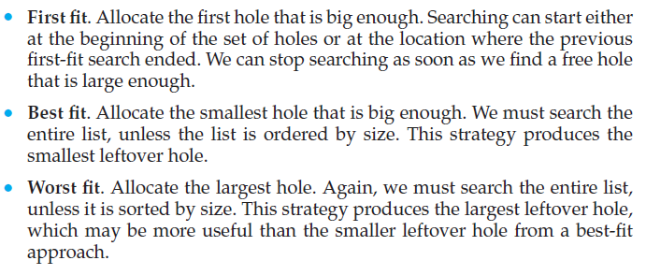

Slide 26
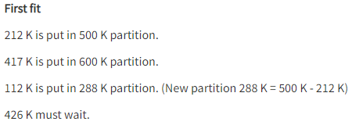
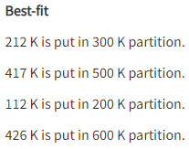
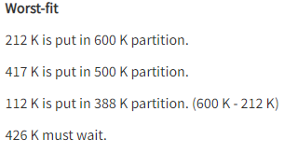
Spot Test
Given memory partition of 100KB, 500KB, 200KB and 600KB (in order), how would each of the first fit , best fit and worst fit algorithms place processes of 212KB ,417KB,112KB and 426KB(in order)?
In this example Best-fit is the best solution

Slide 27
Fragmentation
External Fragmentation – total memory space exists to satisfy a request, but it is not contiguous
Internal Fragmentation – allocated memory may be slightly larger than requested memory; difference between allotted and requested memory is called internal fragmentation
First fit analysis reveals that given N blocks allocated, 0.5 N blocks lost to fragmentation
  1/3 may be unusable -> 50-percent rule

Slide 28
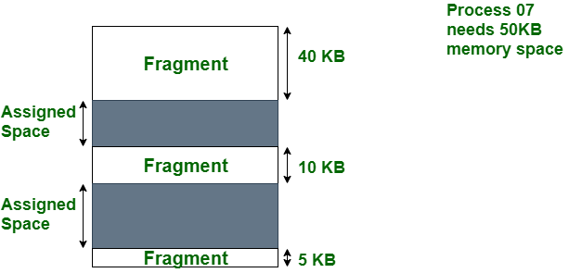
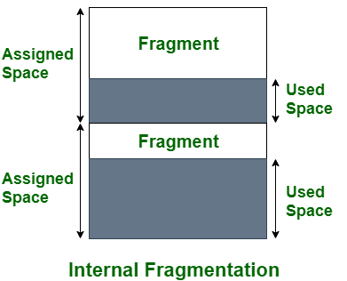
Internal vs External Fragmentation
External Fragmentation
Processes are loaded and removed from memory, the free memory space is broken into little pieces

Slide 29
Fragmentation (Cont.)
Reduce external fragmentation by compaction
  Shuffle memory contents to place all free memory together in one large block
  Compaction is possible only if relocation is dynamic, and is done at execution time
  I/O problem
    Latch job in memory while it is involved in I/O
    Do I/O only into OS buffers
Now consider that backing store has same fragmentation problems
If relocation is dynamic and is done at execution time. If addresses are relocated dynamically, relocation requires only moving the program and data and then changing the base register to reflect the new base address.

Slide 30
Fragmentation (Cont.)
Another possible solution to the external-fragmentation problem is to permit the logical address space of the processes to be noncontiguous, thus allowing a process to be allocated physical memory wherever such memory is available.
Two complementary techniques achieve this solution: segmentation and paging. These techniques can also be combined.

Slide 31
Segmentation
Memory-management scheme that supports user view of memory
  is not the same as the actual physical memory
A program is a collection of segments
  A segment is a logical unit such as:
main program
procedure
function
method
object
local variables, global variables
common block
stack
symbol table
arrays

Slide 32

User’s View of a Program

Slide 33
Logical View of Segmentation
1
1
4
2
3
4
2
3
user space
physical memory space

Slide 34
Segmentation Architecture
Logical address consists of a two tuple:
<segment-number, offset>,
Segment table – maps two-dimensional physical addresses; each table entry has:
  base – contains the starting physical address where the segments reside in memory
  limit – specifies the length of the segment
Segment-table base register (STBR) points to the segment table’s location in memory
Segment-table length register (STLR) indicates number of segments used by a program;
segment number s is legal if s < STLR

Slide 35
Segmentation Architecture (Cont.)
Protection
  With each entry in segment table associate:
    validation bit = 0 ⇒ illegal segment
    read/write/execute privileges
Protection bits associated with segments; code sharing occurs at segment level
Since segments vary in length, memory allocation is a dynamic storage-allocation problem
A segmentation example is shown in the following diagram

Slide 36

Segmentation Hardware

Slide 37
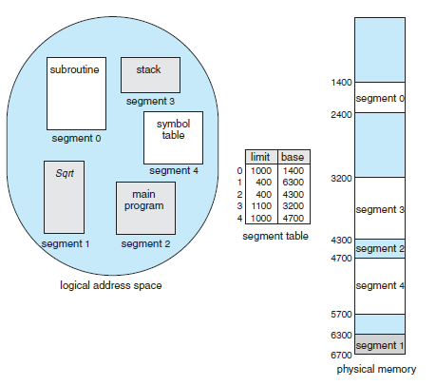
Example of Segmentation (1)

Slide 38
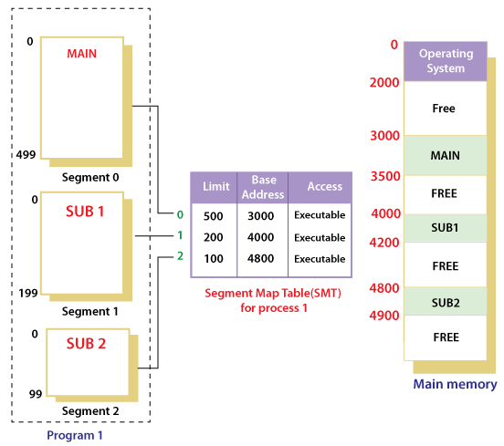
Example of Segmentation (2)

Slide 39
Paging
Physical address space of a process can be noncontiguous; process is allocated physical memory whenever the latter is available
  Avoids external fragmentation
  Avoids problem of varying sized memory chunks
Divide physical memory into fixed-sized blocks called frames
  Size is power of 2, between 512 bytes and 16 Mbytes (depending on computer architecture)
Divide logical memory into blocks of same size called pages
Keep track of all free frames
To run a program of size N pages, need to find N free frames and load program
Set up a page table to translate logical to physical addresses
Backing store likewise split into pages
Still have Internal fragmentation

Slide 40

Address Translation Scheme
Address generated by CPU is divided into:
  Page number (p) – used as an index into a page table which contains base address of each page in physical memory
  Page offset (d) – combined with base address to define the physical memory address that is sent to the memory unit
  For given logical address space 2^{m} and page size 2^{n}
Paging is implemented through cooperation between the operating system and the computer hardware.

Slide 41

Paging Hardware

Slide 42

Paging Model of Logical and Physical Memory

Slide 43

Paging Example
logical address space 2^{m} and page size 2^{n}
n=2 and m=4 32-byte memory and 4-byte pages

Slide 44
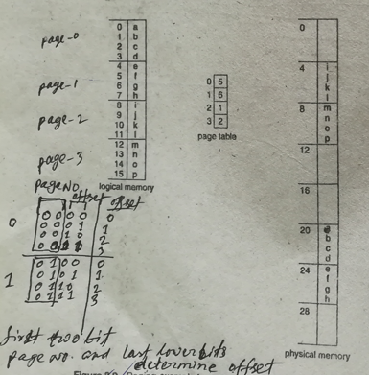

Slide 45
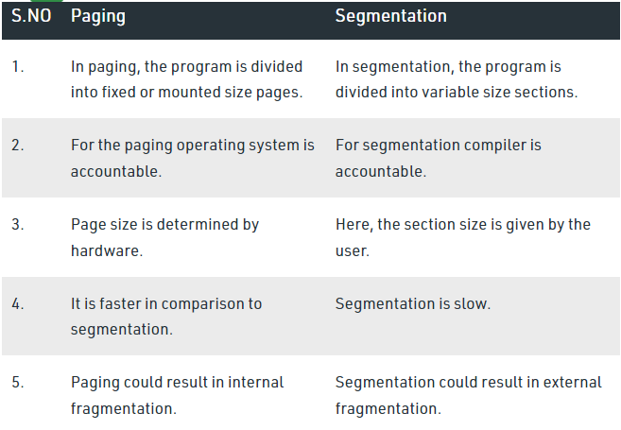
Paging Vs Segmentation
https://www.geeksforgeeks.org/difference-between-paging-and-segmentation/

Slide 46
Paging (Cont.)
Calculating internal fragmentation
  Page size = 2,048 bytes
  Process size = 72,766 bytes
  35 pages + 1,086 bytes
  Internal fragmentation of 2,048 - 1,086 = 962 bytes
  Worst case fragmentation = 1 frame – 1 byte
  On average fragmentation = 1 / 2 frame size
  So small frame sizes desirable?
  But each page table entry takes memory to track
  Page sizes growing over time
    Solaris supports two page sizes – 8 KB and 4 MB
Process view and physical memory now very different
By implementation process can only access its own memory

Slide 47

Free Frames
Before allocation
After allocation

Slide 48
Translation Lookaside Buffer (TLB)
Now the question is where to place the page table, such that overall access time (or reference time) will be less.
  Use register (as they perform faster) to store page tables but the problem is register size is small (not a practical approach)
  To overcome this size issue, the entire page table was kept in main memory. but the problem here is two main memory references are required:
    To find the frame number
    To go to the address specified by frame number
  To overcome this problem a high-speed cache is set up for page table entries (PTE) called a Translation Lookaside Buffer (TLB). Translation Lookaside Buffer (TLB) is nothing but a special cache used to keep track of recently used transactions.

Slide 49
Implementation of Page Table
Page table is kept in main memory
Page-table base register (PTBR) points to the page table
Page-table length register (PTLR) indicates size of the page table
In this scheme every data/instruction access requires two memory accesses
  One for the page table and one for the data / instruction
The two memory access problem can be solved by the use of a special fast-lookup hardware cache called associative memory or translation look-aside buffers (TLBs)

Slide 50
Implementation of Page Table (Cont.)
Some TLBs store address-space identifiers (ASIDs) in each TLB entry – uniquely identifies each process to provide address-space protection for that process
  Otherwise need to flush at every context switch
TLBs typically small (64 to 1,024 entries)
On a TLB miss, value is loaded into the TLB for faster access next time
  Replacement policies must be considered
  Some entries can be wired down for permanent fast access (meaning that they cannot be removed from the TLB)

Slide 51

Paging Hardware With TLB

Slide 52
TLB Steps
Steps in TLB hit:
  CPU generates virtual (logical) address.
  It is checked in TLB (present).
  Corresponding frame number is retrieved, which now tells where in the main memory page lies.
Steps in TLB miss:
  CPU generates virtual (logical) address.
  It is checked in TLB (not present).
  Now the page number is matched to page table residing in main memory (assuming page table contains all PTE).
  Corresponding frame number is retrieved, which now tells where in the main memory page lies.
  The TLB is updated with new PTE (if space is not there, one of the replacement technique comes into picture i.e either FIFO, LRU or MFU etc).

Slide 53
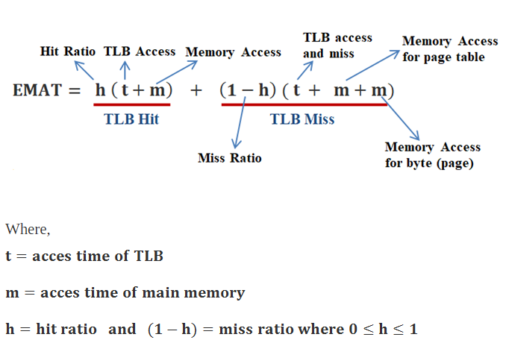
Effective Access Time
Effective memory access time (EMAT): TLB is used to reduce effective memory access time as it is a high speed associative cache.

Slide 54
End of Chapter 8

